Slide 1


The Tools of DH
Filipa Calado
GC Digital Fellow
gofilipa@gmail.com
@caladoscope
Assisting: Rafael Portela
GC Digital Fellow
rdavisportela@gradcenter.cuny.edu
@davis_portela
GO TO:
https://tinyurl.com/y8w2uo74
Workshop slides adapted from Mary Catherine Kinniburgh
@mckinniburgh

Slide 2
What is GCDI?
Graduate Center Digital Initiatives offers different types of support for digital scholarship such as evening workshops, afternoon and evening office hours and working groups based around common tools or data sources, special events such as our annual Digital Showcase and Sound Series, and online resources.
Whether you have participated in our workshops before or your idea of the perfect software is a paperback edition, there is something for you! Our offerings are open to scholars at all levels of digital experience and at all stages of graduate research. Whether you are digitally driven, curious, or defiant, we are prepared to help.

Slide 3
Tool:
DH (Digital Humanities):
A device or implement, especially one held in the hand, used to carry out a particular function.
[in computing]
A piece of software that carries out a particular function, typically creating or modifying another program. (Oxford Enligsh Dictionary)
An area of scholarly activity at the intersection of computing or digital technologies and the disciplines of the humanities…
DH brings digital tools and methods to the study of the humanities with the recognition that the printed word is no longer the main medium for knowledge production and distribution.
Provides new ways of doing computationally engaged research, teaching, and publishing (Wikipedia).

Slide 4
Workshop Goals
We will:
consider what types of project, research, and work are included in the digital humanities,
create a working resource for our own tools of digital humanities,
explore a wide range of methods for research (and project) development.

Slide 5
Digital Humanities projects use...
digital methods of research
that engage humanities topics in their materials
and/or
interpret the results of digital tools from a humanities lens

Slide 6
Things to do with DH
Create community
Theorize, critique, comment
Utilize existing platforms
Develop platforms
Produce data
Process data
Communicate your research in a digital environment
Collect, curate, and display digital materials
And more…

Slide 7
Collaborative Research
Community is fundamental to DH.
So… introduce yourself to the person next to you:
Name
CUNY affiliation? Let us know if you are with Praxis or Social Media Fellows!
Interested in what digital projects or research topics?
...and then you’ll introduce this person to us!

Slide 8

FIRST THINGS FIRST:
ZOTERO
We’re covering a lot, and this will make it easy to save URLs, citations, and get your research going.
All these steps work on your own laptop, too.
Work with your partner to make progress together!

Slide 9
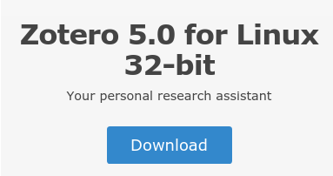
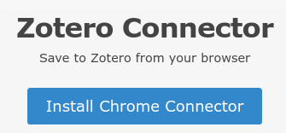
Desktop application
and Connector (browser
extension)
(or MacOS or Windows, depending on your computer)
Go to: https://www.zotero.org/ and click:
2. Then click:
3. Install Zotero in your applications.

Slide 10
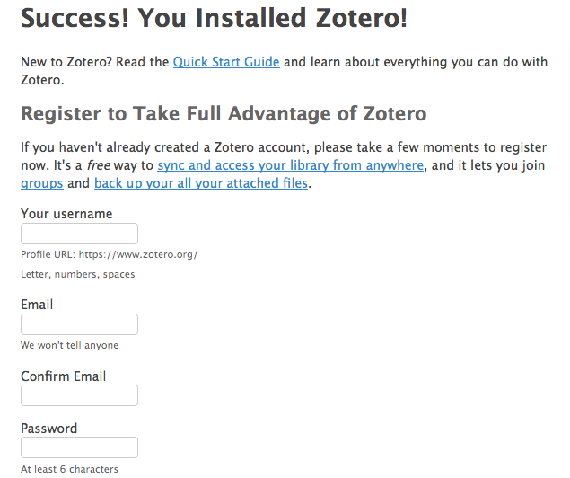
Make Your Account

Slide 11
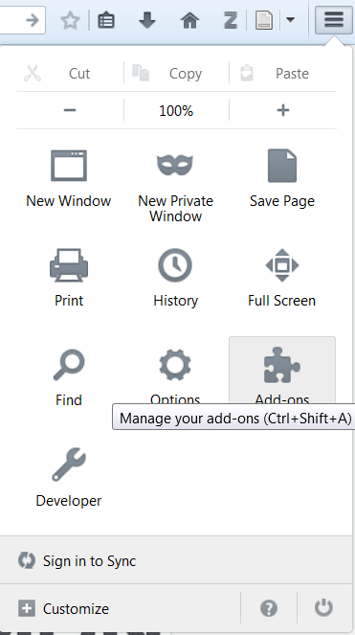
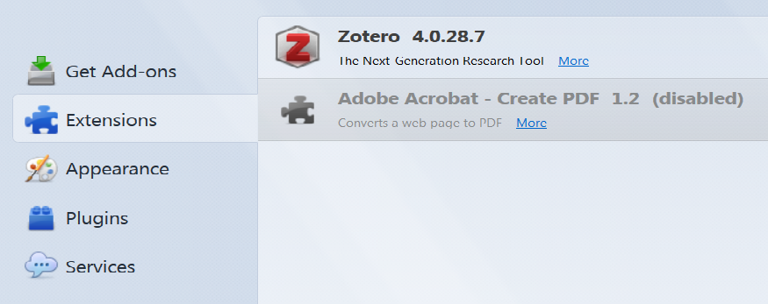
Enable the Extension
Go to the upper right hand corner of Firefox to “Add-ons,” or “Tools/More Tools”, then enable Zotero in “Extensions.”

Slide 12
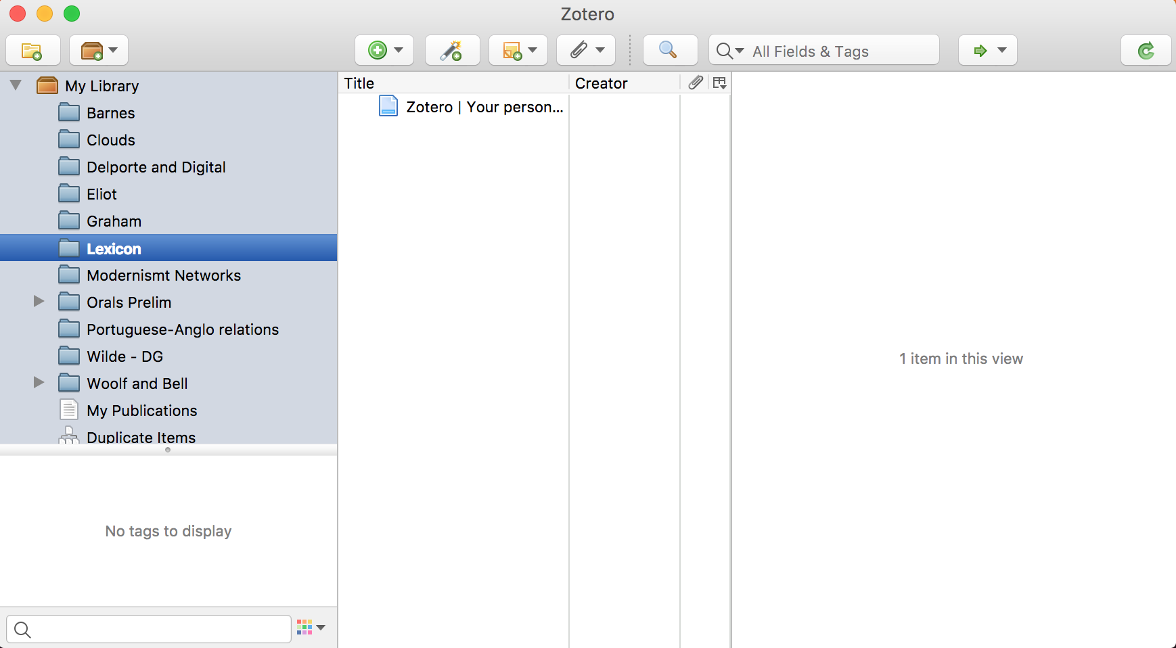


Open Zotero
First:
It will be under your applications, and it should look like the window below:
Second:
After you restart your browser, you will see the
button in the toolbar, which allows you to SAVE that webpage as a citation to Zotero.

Slide 13
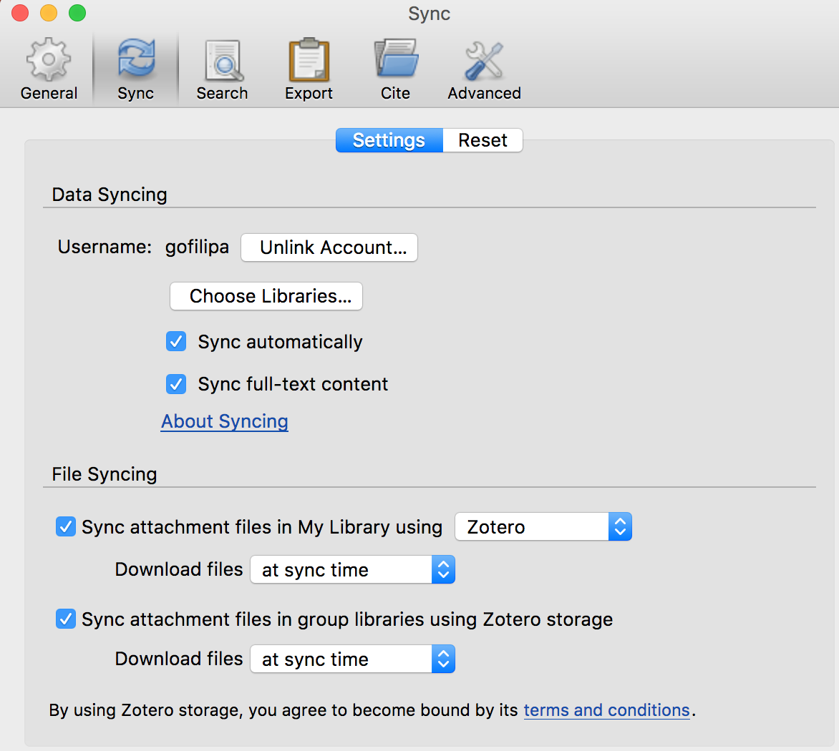
Sync Your Account
Click on “Preferences” under File when Zotero is open.
Go to the “Sync” tab.
Fill in the info for the account you just made on Zotero, and close window.
Now you’re ready to cite! Icons will appear in browser, click to add them to your library.

Slide 14
Okay, ready?

Slide 15
How are you going to get your data?
What kind of data?
Audio / Visual
Web Scraping
Text Analysis
Text Encoding
Geocoding
Where to find it?
online databases
NYC Open Data (can visualize here too!)
DPLA (Digital Public Library of America)
HathiTrust Digital Datasets
institutional repository/collection
NYPL Digital Collections
other suggestions?

Slide 16
Capturing it with: Audio / Visual
Also: Take a picture // make a recording // parsing
uses hardware, software, or even programming language to produce audio or visual content, OR uses software or programming language to parse audio or visual content into data.
Kelsey Chatlosh’s blog post about her GCDI workshop on “Sound”
Tools and Methods:
Downloading/Scanning Photographs
to gather/produce digital images of analogue/digital content. See GIMP for photo editing.
Sound Recording and Analysis
Audacity
Oral History Metadata Synchronizer
Sample Project: ACT UP Oral History

Slide 17
Capturing it with: Web Scraping
uses programming language to gather specific content from static websites or social media, including image and text.
Useful URLS:
Michelle Johnson-McSweeney’s Digital Fellows workshop and online tutorial
Tools and Methods:
API: Application Program Interface:
Functions or procedures that allow you to request data from apps
Works with Twitter, Google Maps, Instagram, eBay
TAGS: scraping Twitter to Google Sheets
Scrapy: open source framework for data extraction from websites
Ethics of Scraping
Sample Project: No Homophobes (uses scraping to capture homophobic speech on Twitter)

Slide 18
Capturing it with: Text Analysis
Tools and Methods:
MALLET: Java-based package (cluster of code)
statistical natural language processing, document classification, clustering, topic modeling, information extraction, etc
Python: multi-use programming language
NLTK (Natural Language Toolkit) collection of libraries for text analysis
Intro to Python workshop next week!
Voyant Tools: web-based text application, copy and paste your text for immediate analysis
Also: Topic Modeling // Text Mining
uses programming languages or software to extract the data, using parameters that you set, from a textual corpus.
Useful URLS:
Ted Underwood’s Seven Ways Humanists use Text Analysis
Tutorial on using MALLET for Topic Modeling

Slide 19
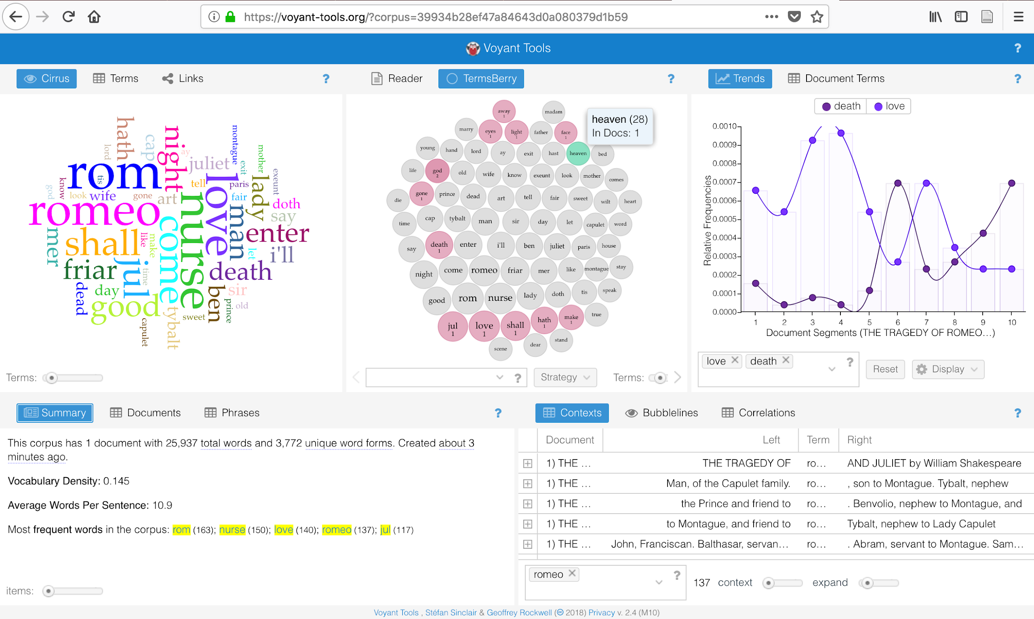

Slide 20
Capturing it with: Text Encoding
Also: Markup
uses markup language (usually XML) to encode a text for specific details which often have an interpretive element, or for display in online environments.
Useful URLS:
“What is XML and Why Should Humanists Care?”
Zotero library for TEI tutorials, examples, models, publications
My own TEI workshop!
Tools and Methods:
XML: eXtensible Markup Language
HTML’s more flexible cousin, which allows you to write your own tags
hence, need for TEI
TEI: Text Encoding Initiative, a standardized system of markup in XML for encoding texts.
archival/museum standard for digital texts
Sample Project: Shelley-Godwin Archive

Slide 21
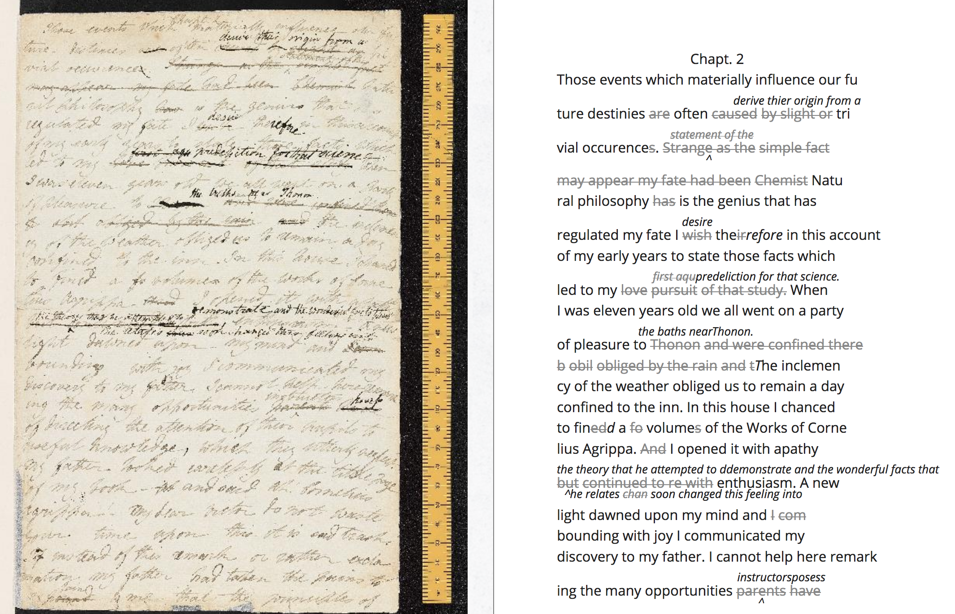
http://shelleygodwinarchive.org/sc/oxford/ms_abinger/c56/#/p5

Slide 22
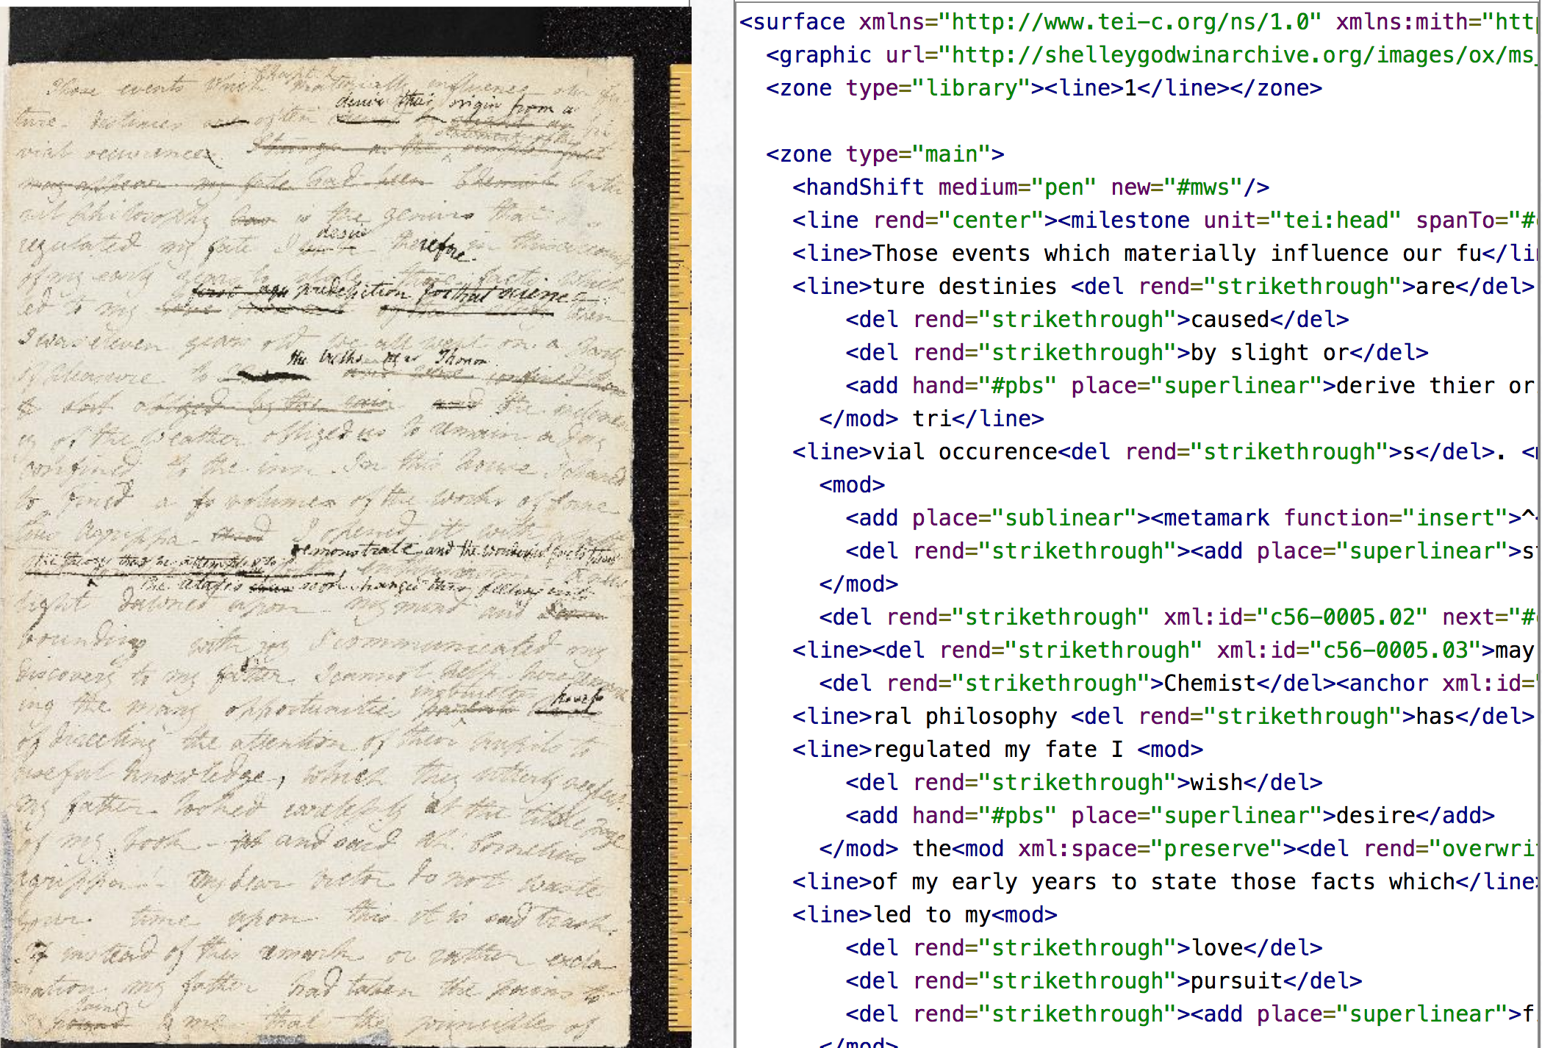

Slide 23
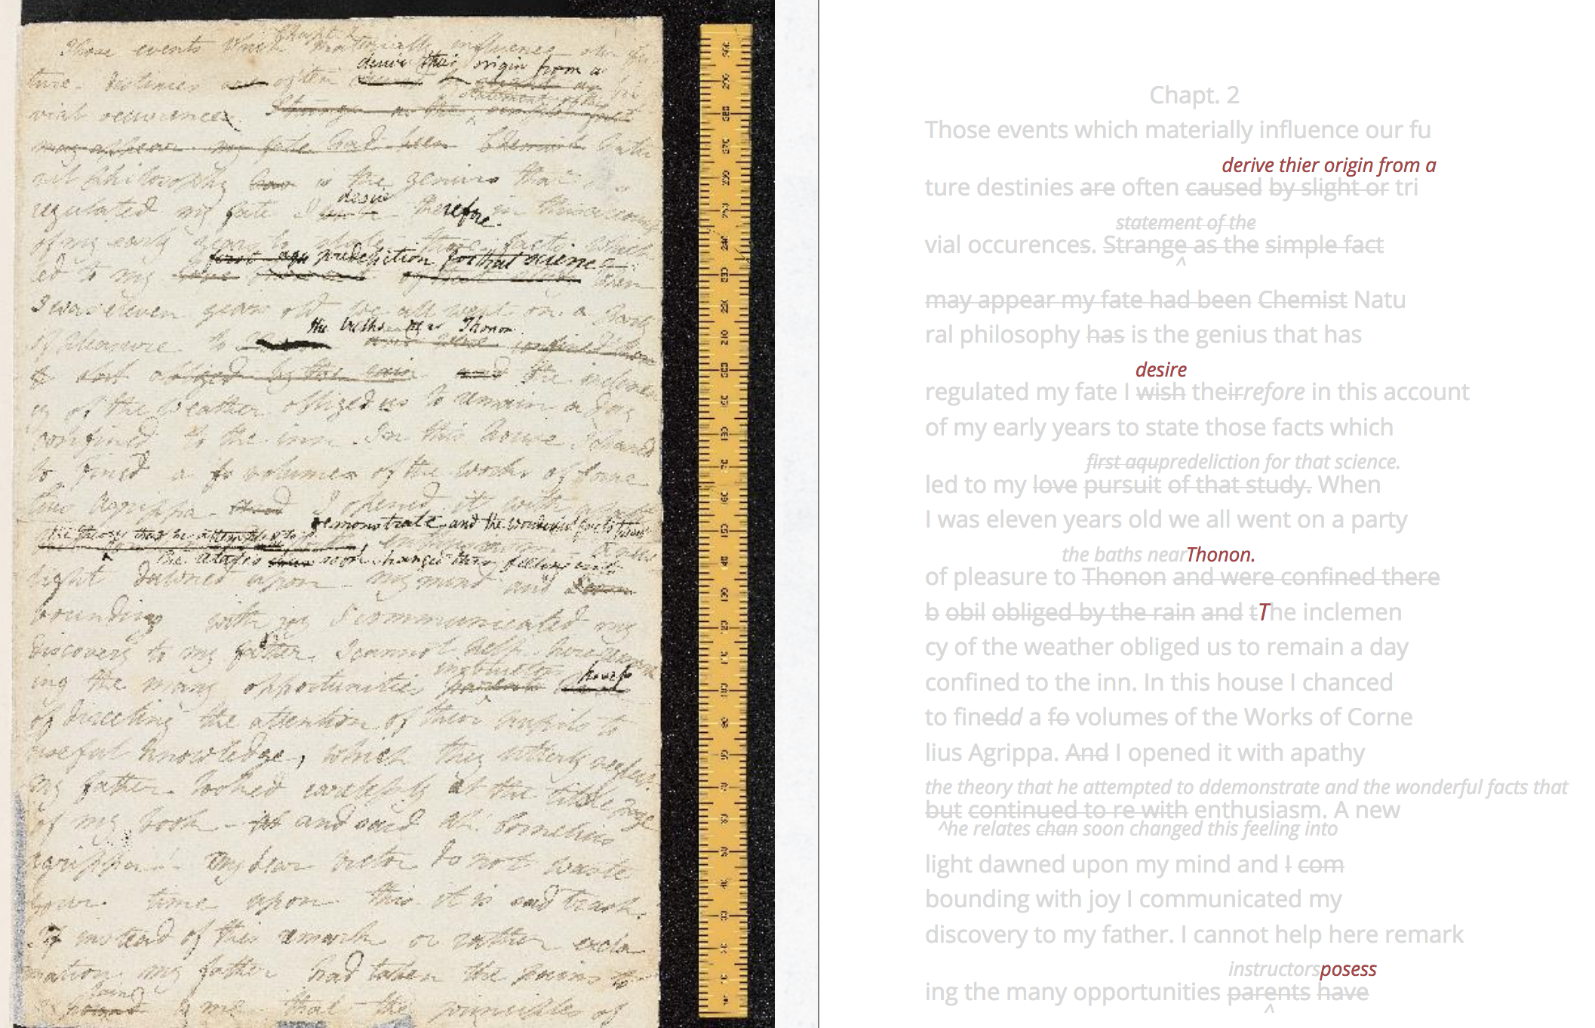
http://shelleygodwinarchive.org/sc/oxford/ms_abinger/c56/#/p5

Slide 24
Capturing it with: Geocoding/tagging
Tools and Methods:
QGIS
free, open-source version of ArcGIS with many of the same features. Create, edit, visualise, analyse and publish geospatial information.
Leaflet
open source Javascript library for adding interactive maps to a webpage, works with mobile.
Sample Project: Mapping Arts, NYC by Data for the Public Good
Geocoding uses software to transform non-coordinate identifiers (such as landmarks) into geospatial coordinates
[Geotagging adds GIS metadata to text, image, or other digital content.]
Useful URLS:
“Finding the Right Tools for Mapping”
Javascripting English Major: course on using Leaflet

Slide 25

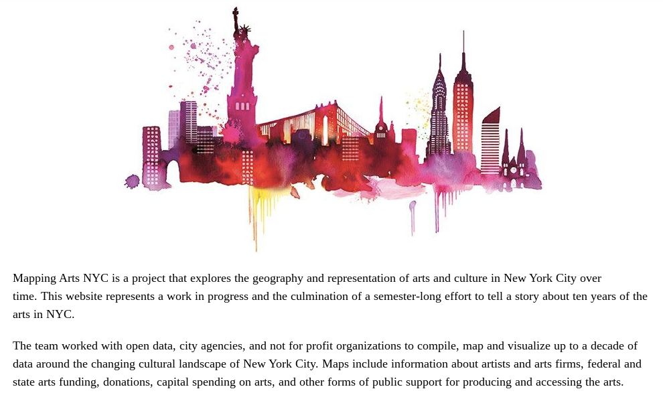
http://gcdiprojects.org/MappingArtsNYC/

Slide 26
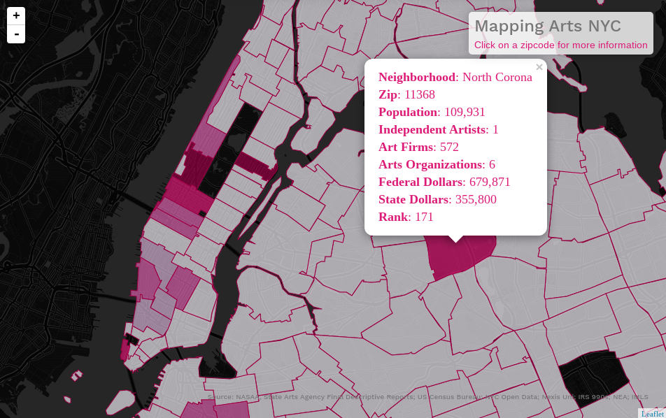

Slide 27

https://www.redbubble.com/people/shappie112/works/23629197-david-s-pumpkins-any-questions-ii?p=poster

Slide 28
Analyzing / Displaying Data
Is this a necessary step? Perhaps not always?
Should we draw a distinction between “analyze” and “display?” Why or why not?
~graph / data visualization as argument, demonstration, or image that must be explicated?

Slide 29
Display / Analyze it: Visually
Also: Data Visualization, Mapping
Maps dataset as a network, graph, or chart.
Consider the role of your tools in creating your visual argument, as well as your audience.
Further Reading:
Drucker, Johanna. “Humanities Approaches to Graphical Display.” DHQ. 5:1 (2011)
“Tools carry with them assumptions of knowledge as observer-independent and certain, rather than observer co-dependent and interpretative… we need a humanities approach to the graphical expression of interpretation.”
Excel or Google Sheets
can generate most basic graphs and charts
Gephi
open-source visualization platform
use Sigma, a Javascript library, to render results interactively in a web browser.
Sample Project: Quantifying Kissinger
computational analysis of the National Security Archive’s Kissinger collection of correspondence.

Slide 30
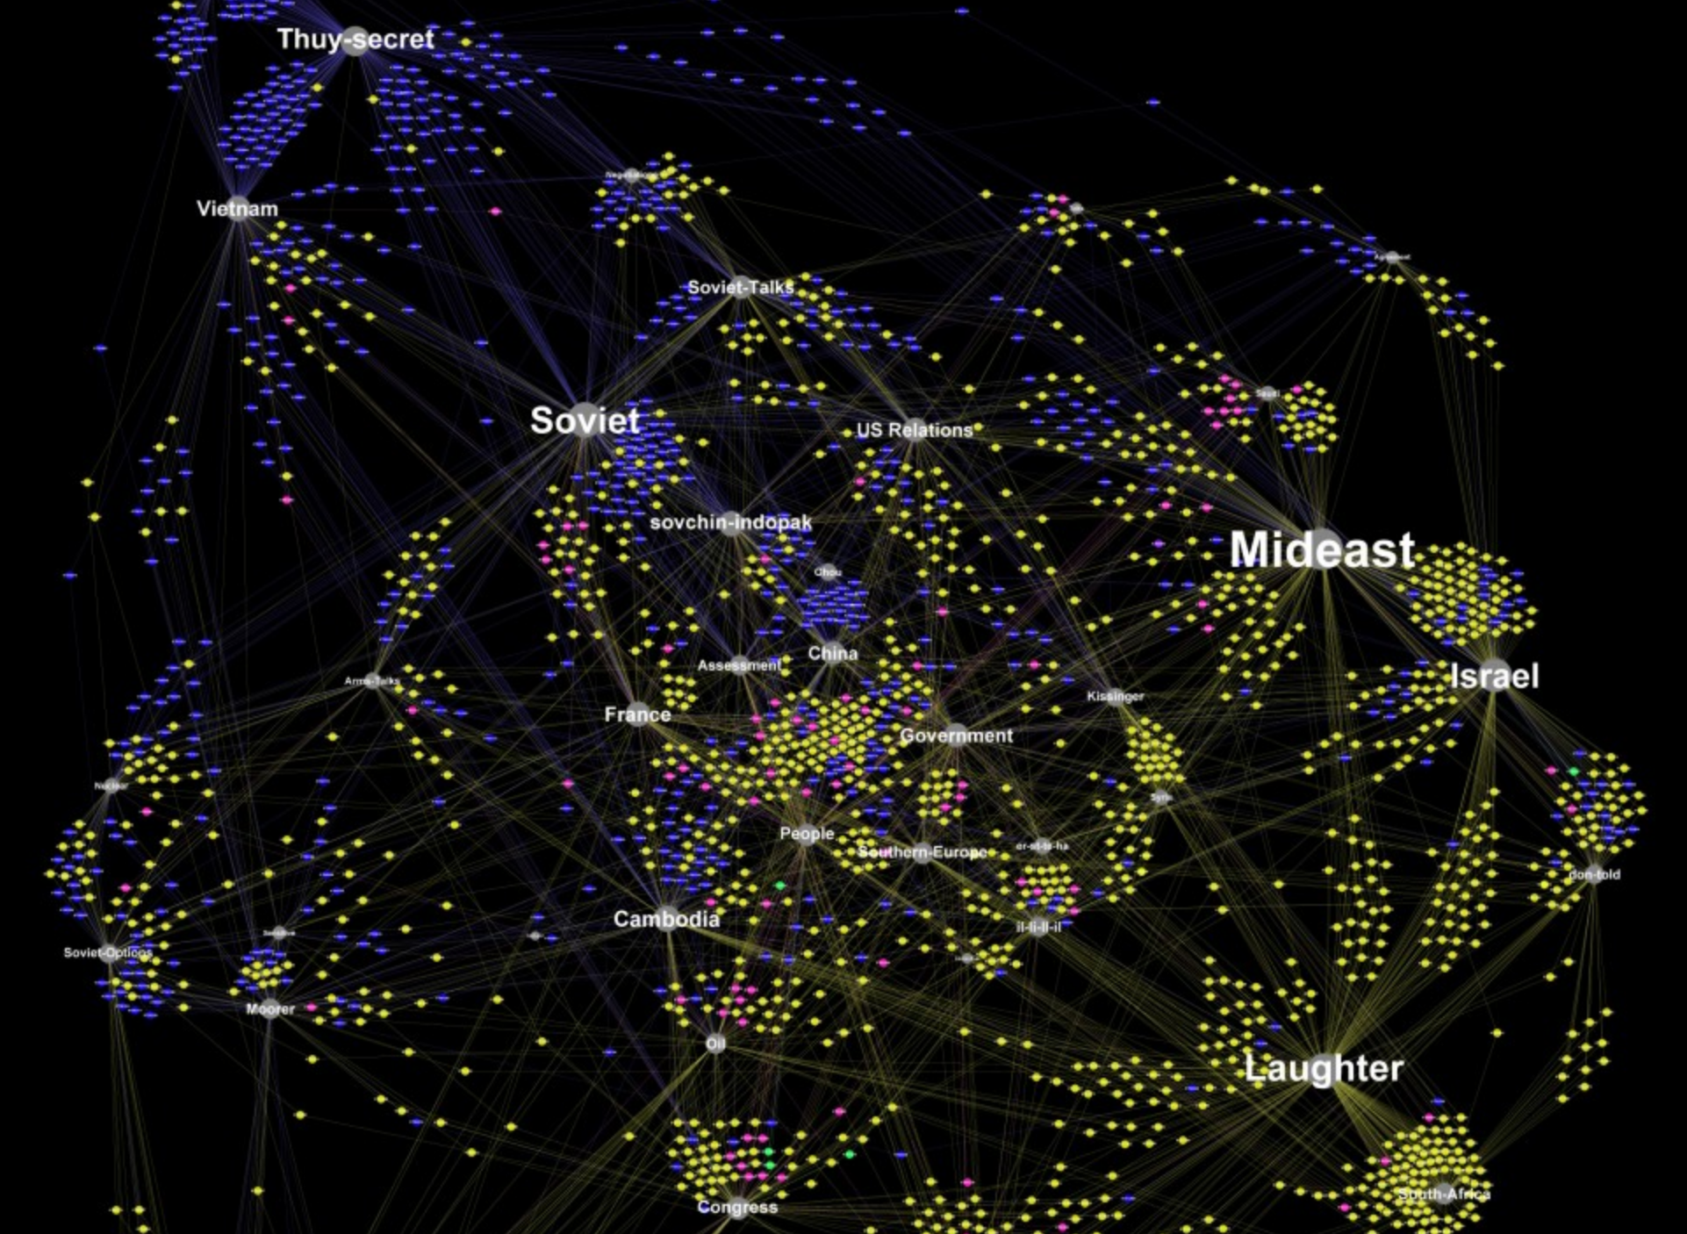
Quantifying Kissinger:
Selected Topics Models:
North-South-Thieu-Vietnam
Saudi-Arab-Oil-Russians
Israel-Asad-Egypt-Syria
Don-told
Soviet-Dobrynin
Southern-Europe
Greece-Turkey
Nuclear-Weapons
Congress-National
Video of time-lapse version
http://blog.quantifyingkissinger.com/category/interactivity/static/

Slide 31
Display / Analyze it: Narratively
Also: Digital Collection, Digital Exhibit, Digital Edition, Web Site, or even essay / article!
Bring disparate digital (or digitized) materials into a cohesive digital resource.
Enable digital communication of ideas between communities for teaching, collaborating, and learning.
Narrative is one of the most powerful and complex tools we have!
Omeka
open source platform for exhibitions (library, museum, archives, and scholarly collections)
Sample Project: Preserve the Baltimore Uprising
Stay tuned for GCDF workshop on Omeka!
CMS (Content Management System)
CUNY Academic Commons
WordPress-based
Manifold
open source platform for scholarly publishing. Good for sharing research, teaching, writing in a collaborative environment.

Slide 32
https://www.redbubble.com/people/shappie112/works/23629197-david-s-pumpkins-any-questions-ii?p=poster

Slide 33
Reflect + Assess
Take five minutes and
consider a
method of displaying or analyzing
specific tool
example of a visualization project
or any hyperlink
from the previous slides or your own web browsing
and address any of the following:
What does the method of display/analysis argue?
How does it argue?
What does the method / tool / project make invisible?
Is the method / tool effective? Why or why not?
Share your results with your partner and/or the class.

Slide 34
Ready for More? Resources at the GC
GC Digital Fellows Office Hours (Alternating Mondays (4-6pm) and Wednesdays (5-7pm), in the Digital Scholarship Lab, Room 7414). We always welcome interested and curious folks at any stage of their project
Workshops offered by the GC Digital Fellows, ITP Program, the GC Library, and the Futures Initiative
GC Digital Initiatives Website and GC Events and Workshop Calendar on the Commons

Slide 35
Debrief.
developed a basic context for DH
explored and critiqued methods, tools, and resources
created a “toolbox”, a working resource in Zotero

Slide 36
Please take a moment to share your feedback:
cuny.is/gcdievals
And keep in touch!
Follow GCDI on Twitter: @cunygcdi
Follow the GC Digital Fellows on Twitter: @digital_fellows
Follow the #digitalGC hashtag on Twitter
Follow the GC Digital Fellows blog, Tagging the Tower: digitalfellows.commons.gc.cuny.edu
Contact the fellows at digitalfellows.commons.gc.cuny.edu/contact-us/
Drop-in to the Digital Scholarship Lab Open House hosted twice per semester, or attend PUG, Events, or Workshops!

Slide 37
The Tools of DH
Filipa Calado
GC Digital Fellow
gofilipa@gmail.com
@caladoscope
Assisting: Rafael Portela
GC Digital Fellow
rdavisportela@gradcenter.cuny.edu
@davis_portela
Survey:
cuny.is/gcdievals
Slides:
https://tinyurl.com/y8w2uo74
THANK YOU!

